Slide 1
Probability Fundamentals

Slide 2
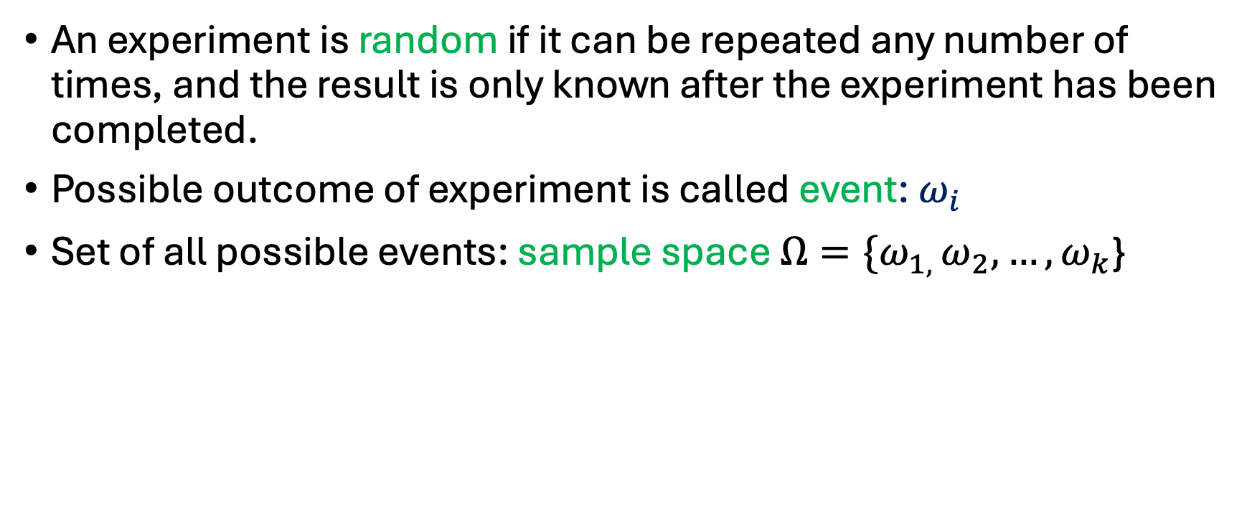
Random experiment
An experiment is random if it can be repeated any number of times, and the result is only known after the experiment has been completed.
Possible outcome of experiment is called event: $ω_{i}$
Set of all possible events: sample space ${Ω=\{ω}_{1, }ω_{2}, …,ω_{k}$}

Slide 3
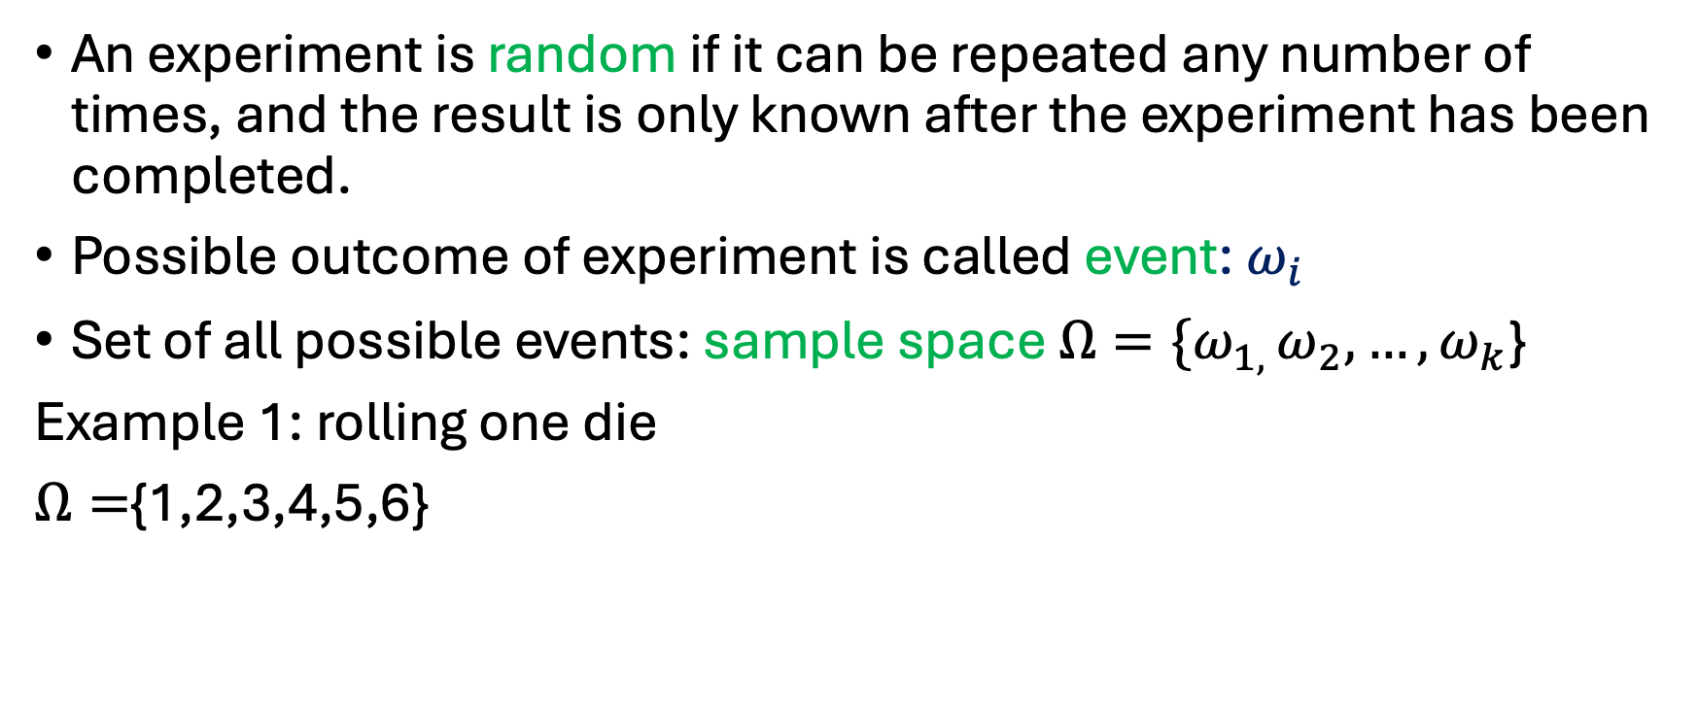
Random experiment
An experiment is random if it can be repeated any number of times, and the result is only known after the experiment has been completed.
Possible outcome of experiment is called event: $ω_{i}$
Set of all possible events: sample space ${Ω=\{ω}_{1, }ω_{2}, …,ω_{k}$}
Example 1: rolling one die
$Ω=${1,2,3,4,5,6}

Slide 4
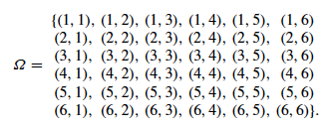
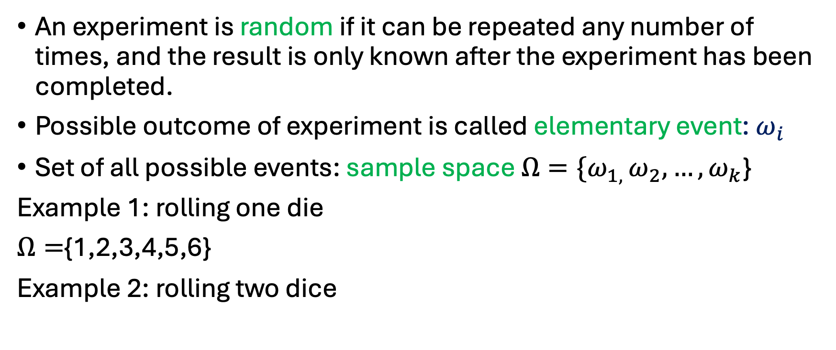
Random experiment
An experiment is random if it can be repeated any number of times, and the result is only known after the experiment has been completed.
Possible outcome of experiment is called elementary event: $ω_{i}$
Set of all possible events: sample space ${Ω=\{ω}_{1, }ω_{2}, …,ω_{k}$}
Example 1: rolling one die
$Ω=${1,2,3,4,5,6}
Example 2: rolling two dice

Slide 5
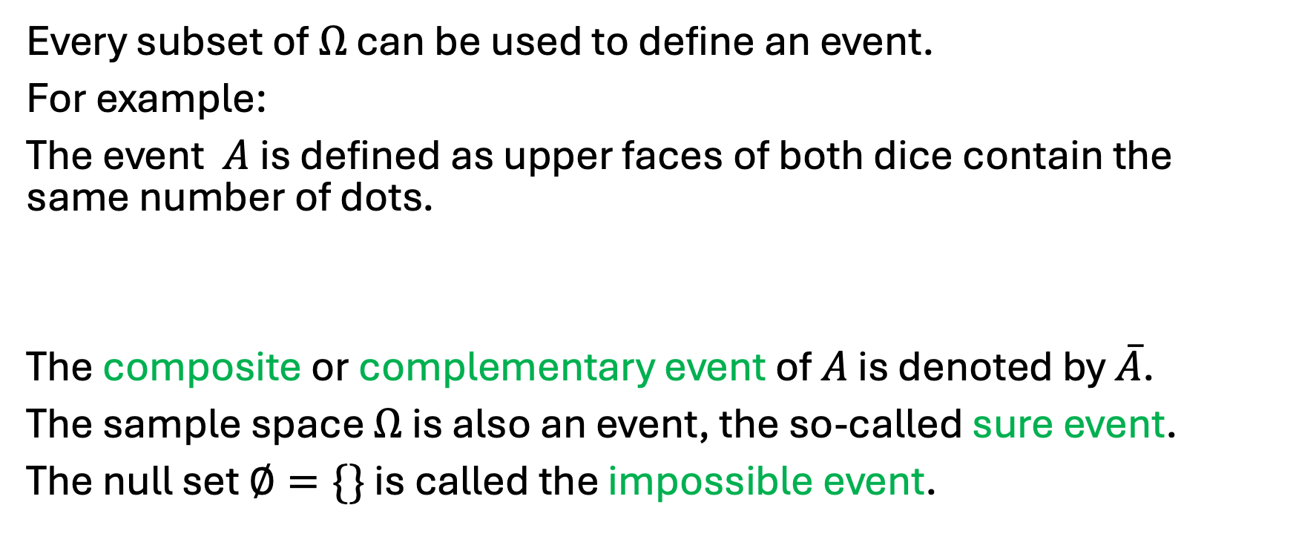
Subsets and events
Every subset of $Ω$ can be used to define an event.
For example:
The event $A$is defined as upper faces of both dice contain the same number of dots.
The composite or complementary event of $A$ is denoted by $\overline{A}$.
The sample space $Ω$ is also an event, the so-called sure event.
The null set $∅=\{\}$ is called the impossible event.

Slide 6
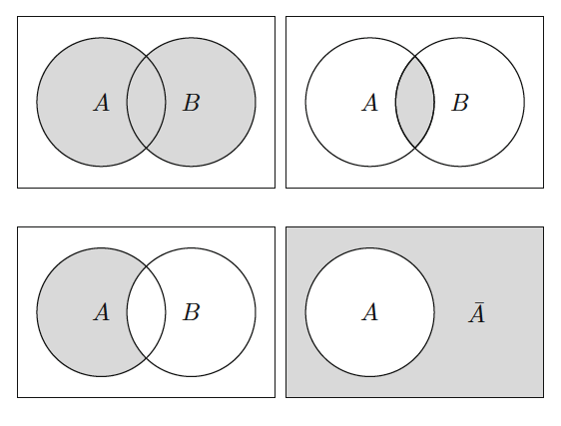



Venn diagrams

Slide 7
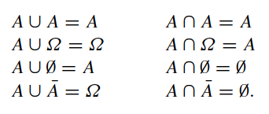
Venn diagrams

Slide 8



Relative frequency and probability
Experiment with m possible outcomes
We perform the experiment n times and calculate the absolute and relative frequencies for each possible outcome.
Now we repeat the experiment a large number of times (n → ∞). The relative frequency will converge to a limiting value.
Probability of outcome $A_{i}$

Slide 9




Relative frequency and probability: example
Toss a fair coin 20 times.
Number of heads
Number of tails
When the coin is tossed a large number of times, both relative frequencies will tend to the value 0.5, which is the probability of getting a heads or a tail.

Slide 10

Laplace probability
Example: rolling two dice
Event A: sum of the dots on the dice is at least 4 and at most 6.
Sum =4: (1,3), (2,2),(3,1)
Sum=5: (1,4),(2,3),(3,2),(4,1)
Sum=6: (1,5),(2,4),(3,3),(4,2),(5,1)
Total number of simple events: 12
Probability of event A= 12/36=1/3

Slide 11
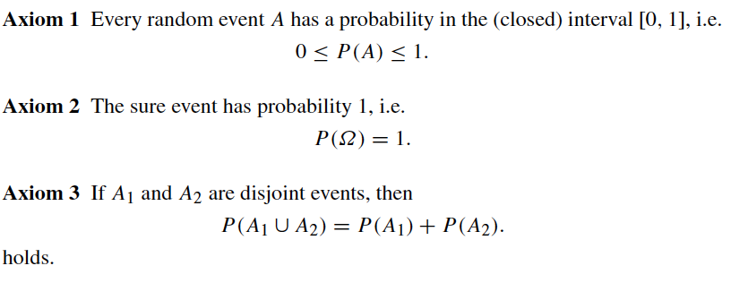
Axioms of probability (Kolmogorov)

Slide 12
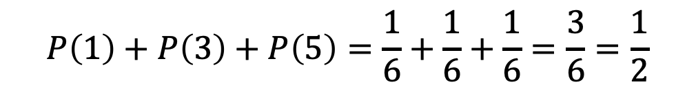
Axioms of probability (Kolmogorov): example
Roll a die. What is the probability of getting an odd number?
$$P\left(1\right)+P\left(3\right)+P\left(5\right)=\frac{1}{6}+\frac{1}{6}+\frac{1}{6}=\frac{3}{6}=\frac{1}{2}$$

Slide 13






Corollaries
1.
2.
3.
If $A_{1}$ and $A_{2}$ are not disjoint:
4.

Slide 14
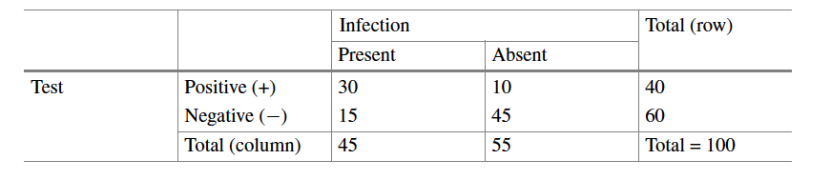
Conditional probability
Example: a new blood test is developed to detect a specific infection. These are the results of the test:
absolute frequencies

Slide 15
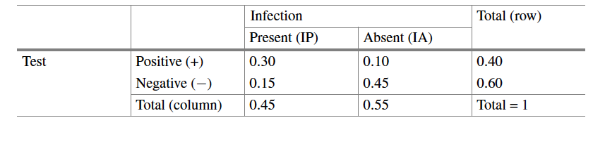
Conditional probability
Example: a new blood test is developed to detect a specific infection. These are the results of the test:
relative frequencies: let’s interpret them as probabilities

Slide 16



Conditional probability
Example: a new blood test is developed to detect a specific infection. These are the results of the test:
What is the probability that the test is positive?
$$P\left(T+\right)=0.30+0.10=0.40$$
What is the probability that the infection is present?
$$P\left(IP\right)=0.30+0.15=0.45$$
What is the probability that the infection is present if the test is positive?

Slide 17


Conditional probability
Probability that the disease is present if the test is positive (conditional frequencies).
Probability that the disease is present and the test is positive (joint relative frequencies).
Marginal probability that the test is positive (marginal relative frequencies).

Slide 18





Conditional probability
Probability that event B occurs given that event A has already occurred.
Probability that event A occurs given that event B has already occurred.

Slide 19
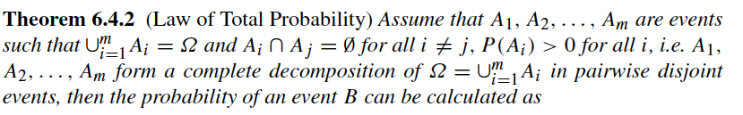
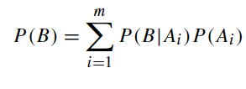
Law of total probability

Slide 20


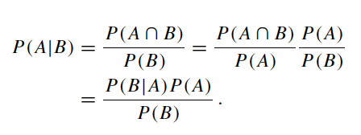

Bayes’ theorem
What is the connection between and ?
(assuming that )

Slide 21

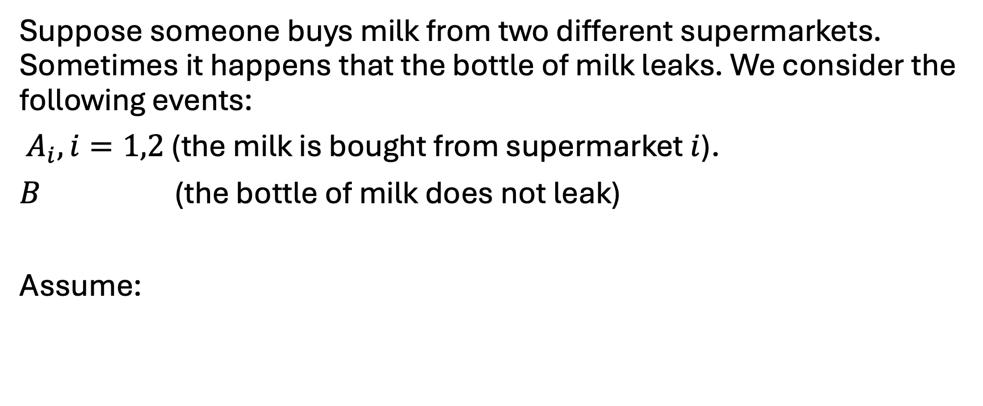
Bayes’ theorem: example
Suppose someone buys milk from two different supermarkets. Sometimes it happens that the bottle of milk leaks. We consider the following events:
$A_{i}, i=1,2$ (the milk is bought from supermarket $i$).
$B$ (the bottle of milk does not leak)
Assume:
What is the probability that the milk does not leak?

Slide 22


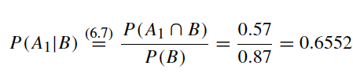
Bayes’ theorem: example
What is the probability that the milk does not leak?
What is the probability that the milk was bought from supermarket 1 and it does not leak?
Now suppose that the milk does not leak. What is the probability that it was bought from supermarket 1?

Slide 23

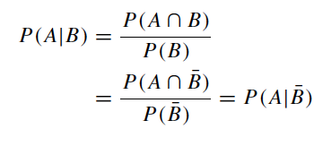


Independence
Two events A and B are independent if the probability of occurrence of B has no effect on the probability that A occurs.

Slide 24

Independence
Two events are said to be (stochastically) independent if:
The probability that A and B occur is equal to the product of the individual probabilities of occurrence of A and B.

Slide 25


Independent variables
Remember from the second lecture (Association of two variables):
Two variables are considered independent if the observations on one variable do not affect the observations on the other variable (e.g. two persons rolling a die separately).
If two variables are independent, then:

Slide 26
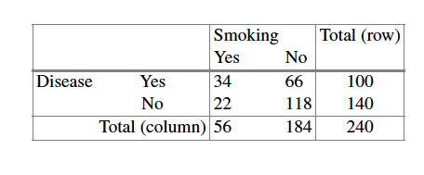


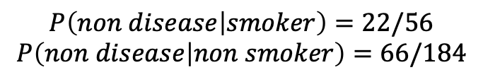
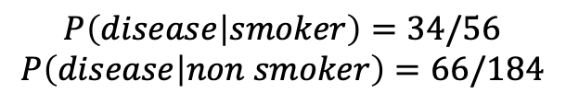
Remember from the second lecture (Association of two variables):
Relative risks: example
The proportion of individuals with the disease is 1.69 times higher among smokers.
$$P\left(disease | smoker\right)=34/56$$
$$P\left(disease | non smoker\right)=66/184$$
$$P\left(non disease | smoker\right)=22/56$$
$$P\left(non disease | non smoker\right)=66/184$$
The proportion of healthy individuals is 0.61 times smaller among smokers.

